Slide 1

Time-series forecasting using Python
Arip S. Nur
L20583502

Slide 2


Datasets
Daily high level historical data of Edward Aquifer-J17 can be downloaded in : https://www.edwardsaquifer.org/science-maps/aquifer-data/historical-data/
Spring flow at 08168710 Comal Springs at New Braunfels, TX (https://waterdata.usgs.gov/nwis/dv?referred_module=sw&site_no=08168710)
Spring flow at 08170000 San Marcos Springs at San Marcos, TX (https://waterdata.usgs.gov/nwis/dv/?site_no=08170000)

Slide 3
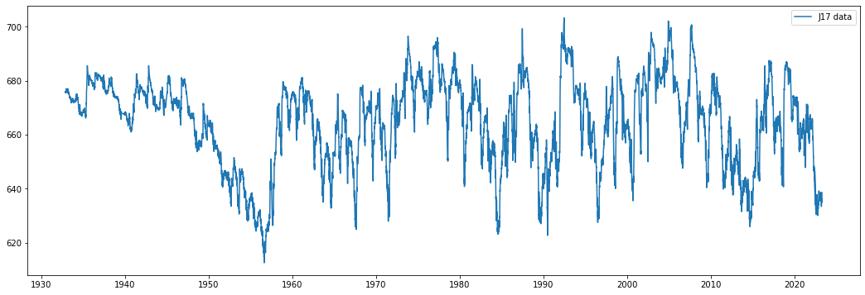
J17 Datasets

Slide 4
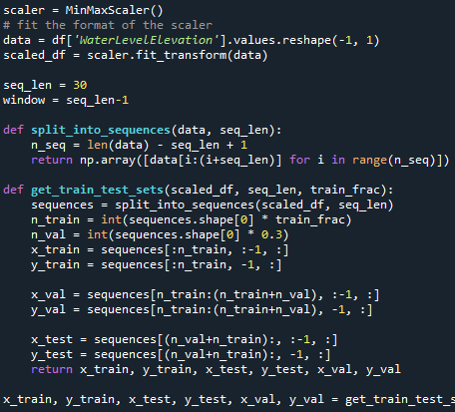
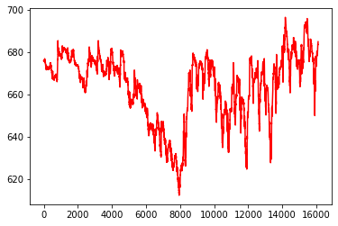
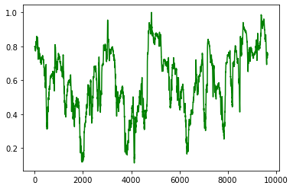
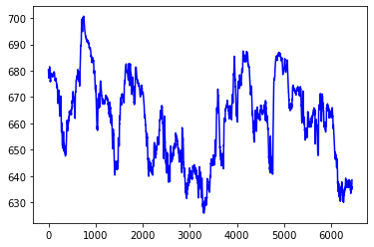
J17 Datasets

Slide 5
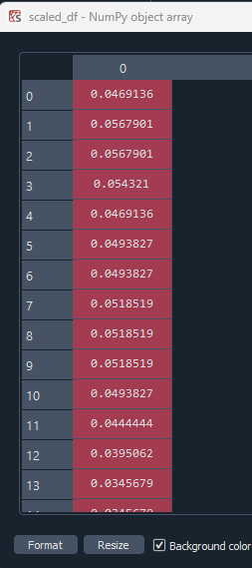
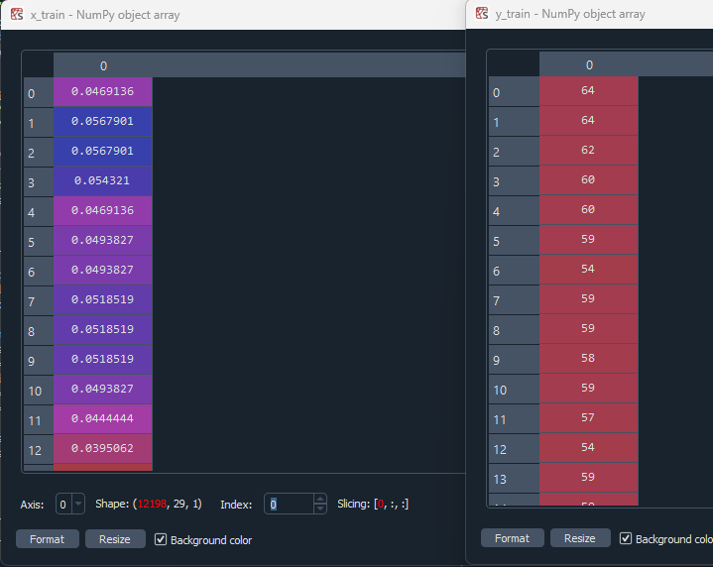
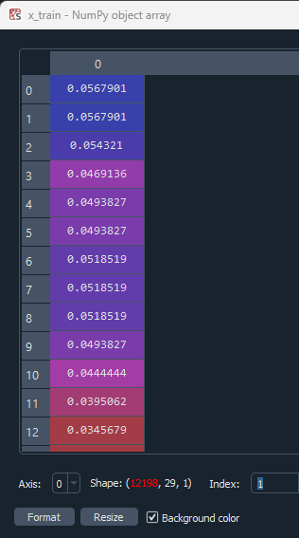
Train, Validation, and test datasets
Slicing (0, 29, 1)
Slicing (1, 29, 1)

Slide 6
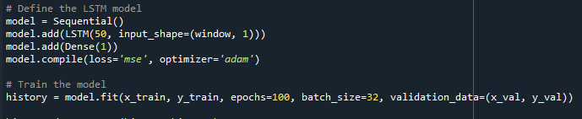
LSTM Model

Slide 7
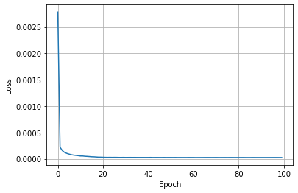
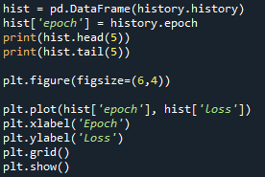
LSTM Loss

Slide 8
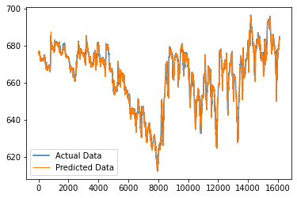
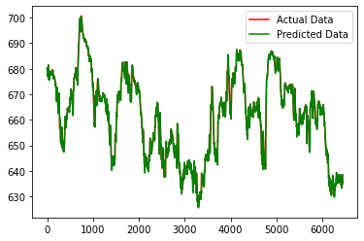
Prediction results
RMSE: 0.41

Slide 9
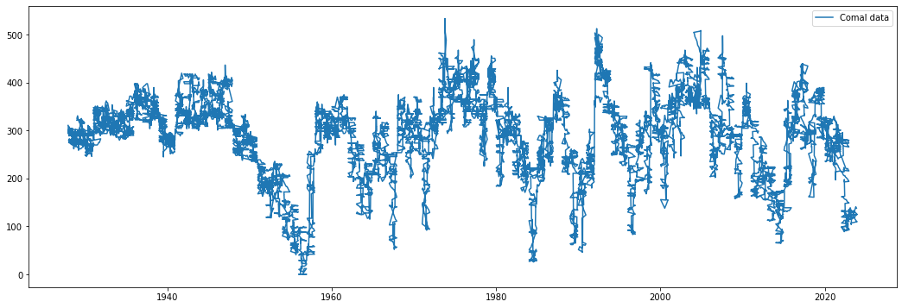
Comal Datasets

Slide 10
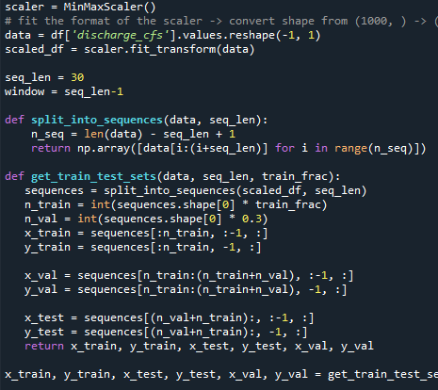
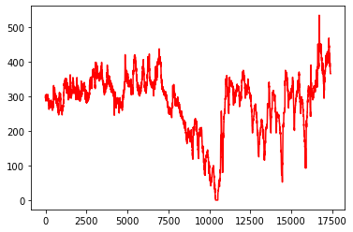
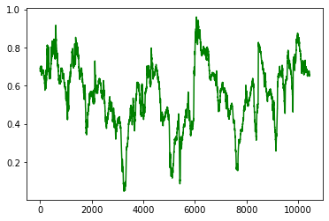
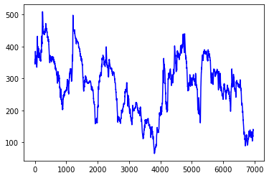
Comal Datasets

Slide 11
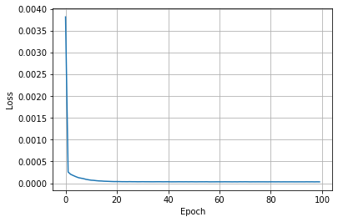
LSTM Loss

Slide 12
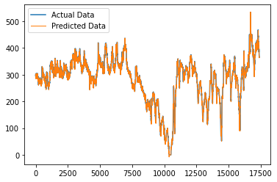
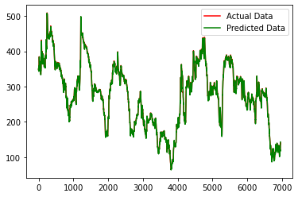
Prediction results
RMSE: 2.72

Slide 13
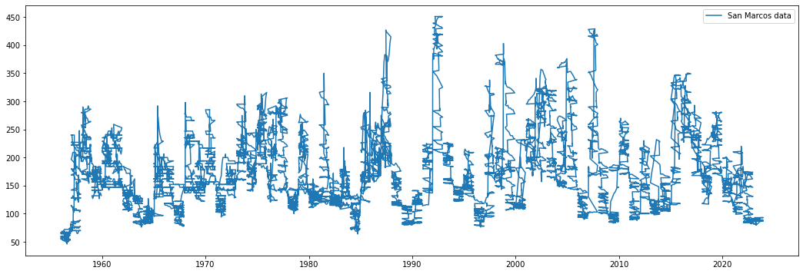
San Marcos Datasets

Slide 14
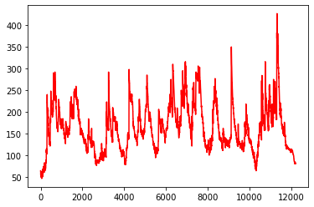
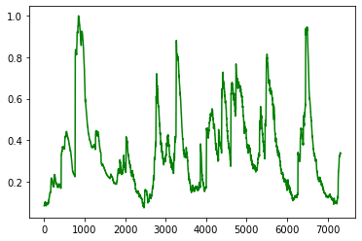
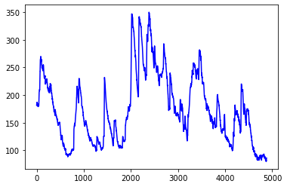
Comal Datasets

Slide 15
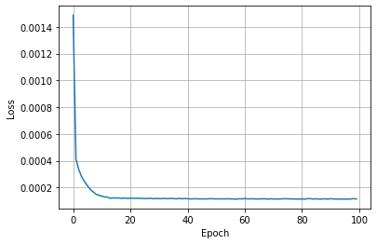
LSTM Loss

Slide 16
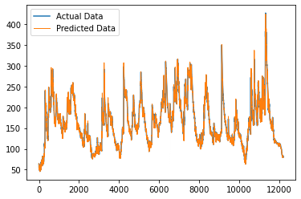
Prediction results
RMSE: 1.88

Slide 17
Thank you
Arip Syaripudin Nur​
anur@lamar.edu

